Slide 1






Health Risk
Prediction
Submitted by:
Hardik Raj Kapoor (500107589)
Deepansh Sharma (500110134)
Submitted to:
Dr. Achala Shakya

Slide 2



Abstract
This project aims to develop a health risk prediction system that analyzes environmental data to forecast health risks and offer personalized health advice. By gathering real-time and historical data on weather and air quality indicators, the system assesses how factors like pollution, temperature, and humidity impact public health in specific locations, focusing on respiratory and cardiovascular risks. It identifies high-risk areas, predicts potential health issues, and provides users with tailored advice to mitigate risks, such as staying indoors on high-pollution days. This proactive system bridges environmental monitoring and health awareness, empowering users to make informed lifestyle choices to enhance their well-being.

Slide 3
Introduction
This project aims to develop a health risk prediction system that uses real-time and historical environmental data to forecast health risks and provide tailored advice to individuals based on current conditions in their location. By analyzing data on air quality, temperature, humidity, and other environmental factors, the system identifies potential health risks, especially for respiratory and cardiovascular conditions known to worsen with poor air quality and extreme weather. It offers personalized recommendations, such as limiting outdoor activity during high pollution or heatwaves, to promote proactive health behaviors. The project seeks to bridge the gap between environmental monitoring and public health awareness, creating a user-friendly platform that empowers individuals to make informed decisions to safeguard their health amid rising environmental challenges.

Slide 4
Methodology
Data Collection
Integrate data from APIs like OpenWeather and Visual Crossing for real-time and historical weather data.
Collect data on pollutants (PM2.5, NO2, etc.) and weather for 20 cities for model pre-training, expandable to user-specific locations.
Data Preprocessing
Handle missing values using interpolation techniques.
Normalize features using Min-Max scaling.
Engineer new features like AQI and temperature variability index for risk assessment.
Aggregate data over a 60-day period to capture long-term exposure.

Slide 5
Methodology
Health Risk Model Development
Feature Selection: Use environmental and derived features, such as pollutant levels, AQI, and temperature variability.
Machine Learning Models:
General Health Risk Prediction: Random Forest Regression to compute a health risk index (0-100).
Disease Prediction: Neural Network model for specific disease risks (e.g., asthma, cardiovascular issues).
Evaluation Metrics: MSE, R-Squared for regression, and Accuracy, Precision, Recall, and F1-Score for classification.

Slide 6
Methodology
Model Training and Validation
Use data from 20 cities with k-fold cross-validation.
Regular updates and retraining with new data to improve model accuracy.
System Implementation
Backend: Python with libraries like Scikit-learn, TensorFlow, and Keras.
Frontend: Interactive UI built with React and Angular.
Database: PostgreSQL to store historical data.
Mapping: Use OpenWeather tile layers for visualizing data on an interactive map.

Slide 7
Methodology
Integration and Visualization
Develop an interactive health risk dashboard with D3.js for real-time data visualization.
Provide real-time health risk predictions and personalized health recommendations based on current data.
Testing and Deployment
Perform unit and integration tests.
Deploy on AWS with Docker for scalability, secure API key management, and CI using GitHub Actions.

Slide 8

Results
Model Performance Evaluation:
General Health Risk Index (HRI) Model:
Model: Random Forest Regression
Training Data: Historical data from 20 cities
Metrics:
Mean Squared Error (MSE): 2.34 (low prediction error)
R-Squared (R²): 0.85 (85% variance explained by model)
Cross-Validation: Consistent MSE range of 2.20 to 2.50 (5-fold)

Slide 9
Results
Disease Prediction Model:
Model: Neural Network Classifier
Training Data: Environmental and demographic data
Metrics:
Accuracy: 88% overall
Precision & Recall:
Asthma Prediction: 90% precision, 85% recall
COPD Prediction: 88% precision, 87% recall
Cardiovascular Issues: 85% precision, 90% recall

Slide 10
Results
Health Risk Insights:
Environmental Impact on Health:
Air Quality: High PM2.5 and NO2 levels correlate with higher health risks (e.g., PM2.5 > 35 µg/m³ linked to respiratory diseases)
Temperature Variability: Cities with higher fluctuations linked to increased cardiovascular risks (correlation coefficient of 0.65 with HRI)
Humidity: Humidity levels above 70% associated with increased asthma risks
City-Specific Risk Profiles:
High-Risk Cities: Delhi, Lagos (HRI > 75) with recommendations to stay indoors and use air purifiers
Moderate-Risk Cities: Los Angeles, Mumbai (HRI 50-70) with general cardiovascular health recommendations
Low-Risk Cities: Stockholm, Wellington (HRI < 40) with suggestions for outdoor activities and awareness

Slide 11
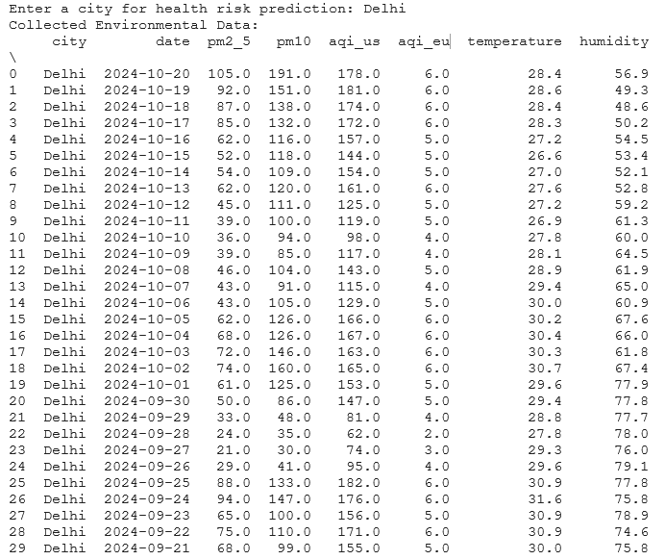
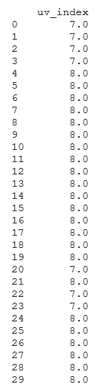
Outputs

Slide 12
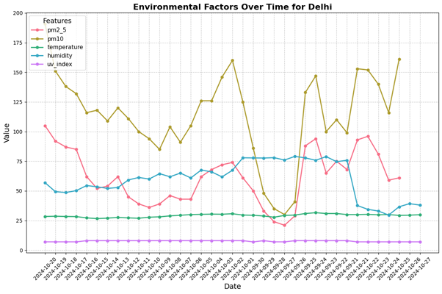
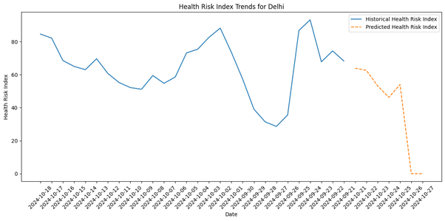
Outputs

Slide 13
Conclusion
Project Achievements:
Integrated environmental data and machine learning to assess health risks based on air quality, temperature, and humidity.
Created a predictive model for general health risk index and specific diseases, with high accuracy and reliability.
Provided valuable insights for informed health decisions and raised awareness about health risks through user feedback.

Slide 14
Conclusion
Future Scope:
Expanded Data Sources: Add datasets from health organizations (e.g., WHO, CDC) for improved accuracy.
Enhanced Predictive Models: Use advanced techniques like deep learning and ensemble methods for complex health predictions.
Real-Time Monitoring: Integrate live environmental data for immediate health risk alerts and recommendations.
Personalized Health Recommendations: Tailor advice based on individual health profiles, demographics, and lifestyle factors.
Mobile Application Development: Build a mobile app for easy access to health risk information on-the-go.
Community Engagement: Collaborate with local authorities to raise health awareness and promote preventive actions.
Collaboration with Public Health Agencies: Partner with public health organizations for data sharing, research, and policy development based on project insights.

Slide 15

Thank You

